Slide 1

[Samsung PRISM] Mid Review Report
Best AP selection using AP score prediction
Team
College Professor(s): Dr. KAYARVIZHY N
Students:
Akash V
Ajit J Gupta
Manoj Howale S
Department: AI/Ml, EEE, CSE
Date: 24 MAY 2023

Slide 2

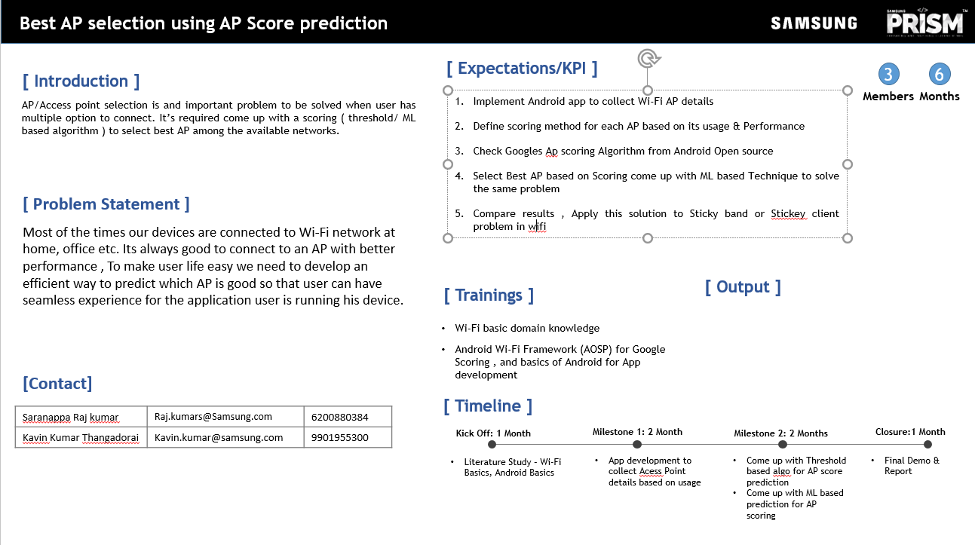
Notes:
-

Slide 3
Proposed Approach / Solution
Concept Diagram :
Network 1
Parameters collected by the mobile application
CSV file created from the data collected
ML model built on the csv file
Best access point is predicted
Network 2
Network 3

Slide 4
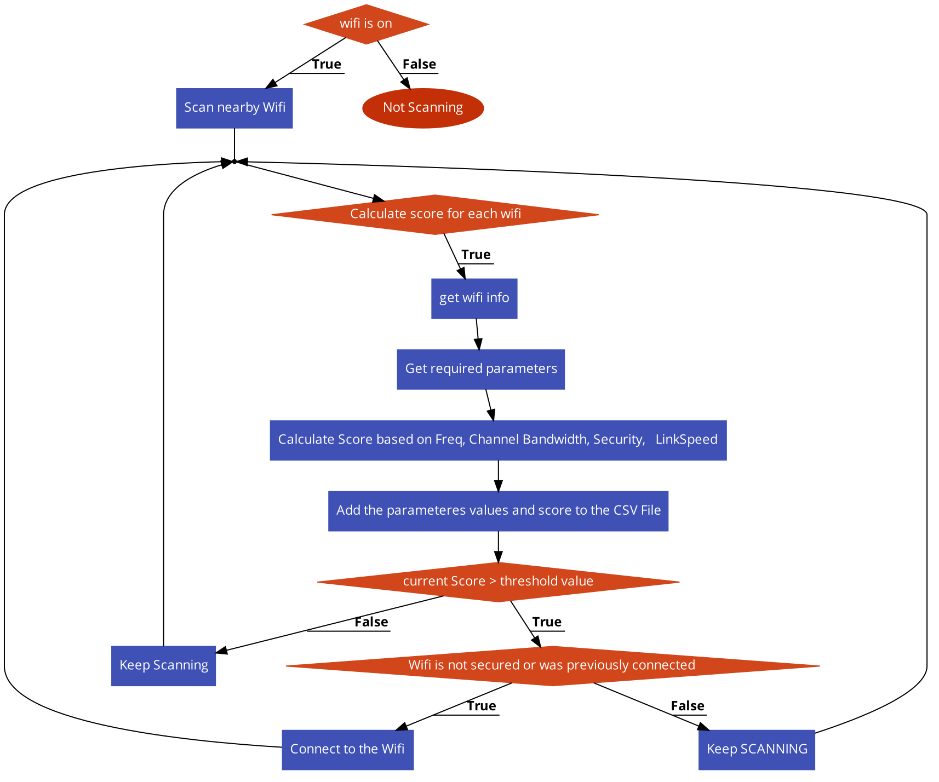
Concept Flowchart :

Slide 5
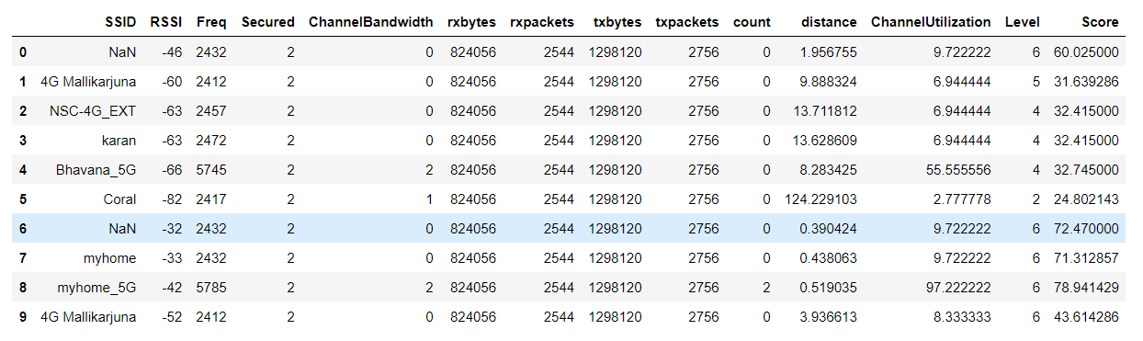
Dataset

Slide 6
Dataset(s) Analysis / Description
Dataset Capture / Preparation / Generation :
Real-time dataset was prepared by running the app in the background in the phone, while running day to day applications and actions like downloading and uploading content to obtain variance.
Every ten seconds the receiver refreshes to prevent redundant data entries.
Dataset Understanding / Analysis :
The major features in the dataset are : RSSI, Frequency ,Channel Bandwidth, Traffic parameters, Previous number of connections, and channel utilization.
Most of the columns are correlated at some point.
Dataset Preprocessing / Related Challenges (if any) :
Cleaned outliers.
Removed duplicates

Slide 7
Formulas used
Distance - double exp = (27.55 - (20 * Math.log10(frequency)) + Math.abs(signalLevel)) / 20.0;
distance = pow(10.0, exp);
Channel Bandwidth = if (frequency >= 2412 && frequency <= 2472) {
return 20;
else if (frequency >= 5170 && frequency <= 5825) { scanresult.bandwidth
Channel utilization = double dataRate = bandwidth1 * getMCS(rssi);
double maxDataRate = bandwidth * 72;
double channelUtilization = dataRate / maxDataRate * 100;
NScore= (pow((100+RSSI)/10),2) +Freq/1000 + (1+ (14/1 + 0.02*distance)) + count +ChannelBandwidth
traffic Score = np.log2(rxbytes) + np.log2(rxpackets) + np.log2(txbytes) + np.log2(txpackets)
scale = max(trafficScore)/min(trafficScore)
mini = min(trafficScore)
trafficScore = ((trafficScore -mini)*scale)+1
SCORE = NScore + trafficScore

Slide 8
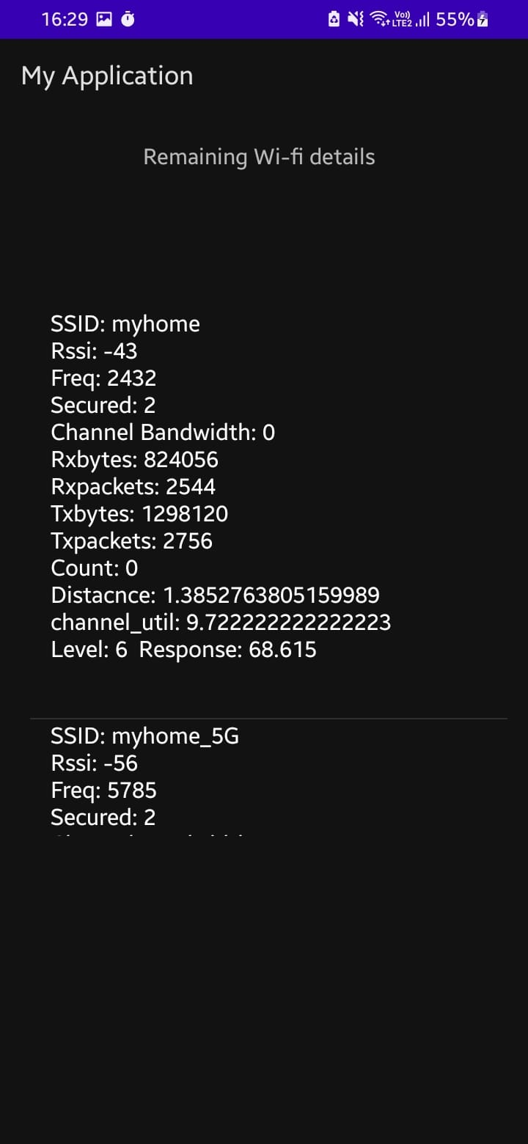
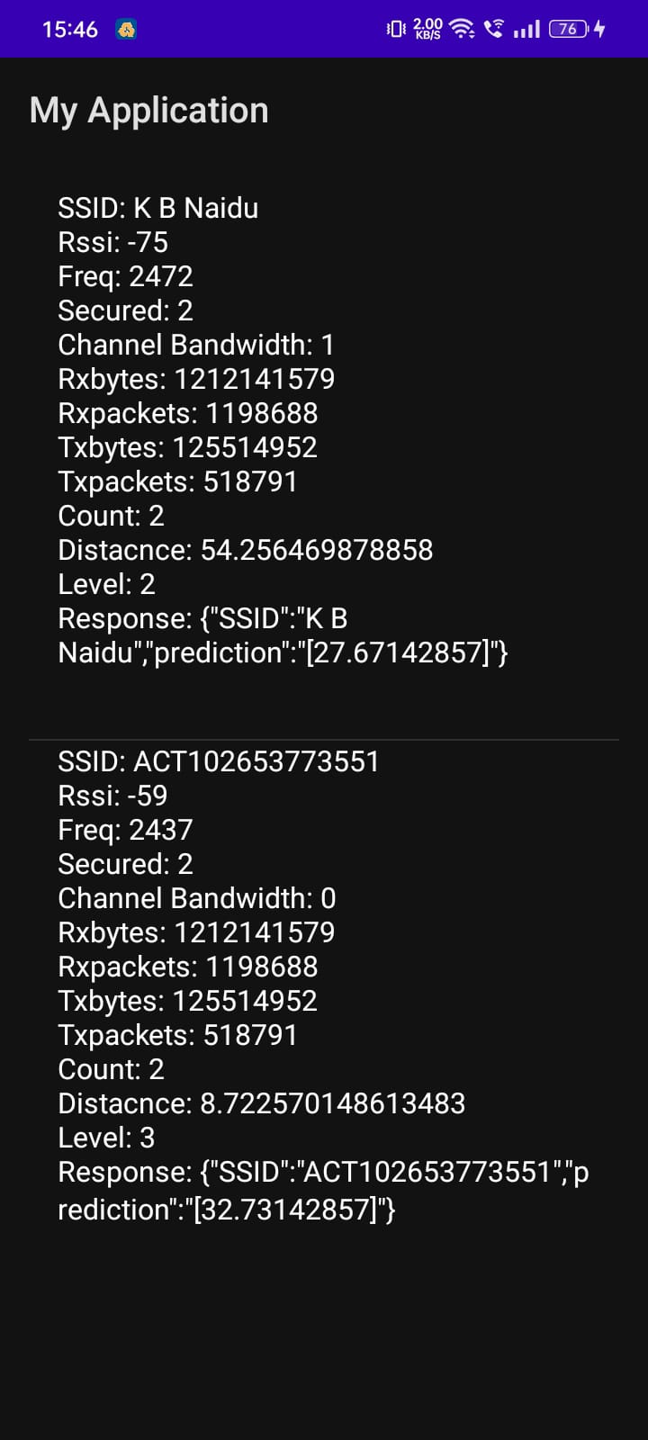
Experimental Results / Simulations / Observations
Screenshot of the APP (collecting dataset) :
Screenshot of the APP (For User) :

Slide 9
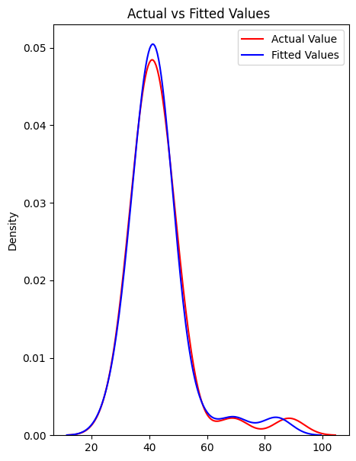
Results
Model Name | Accuracy
Random Forest | 96.64
Decision Tree Regressor | 95.76
Linear Regressor | 93.34
Actual vs Fit graph (Random Forest)

Slide 10
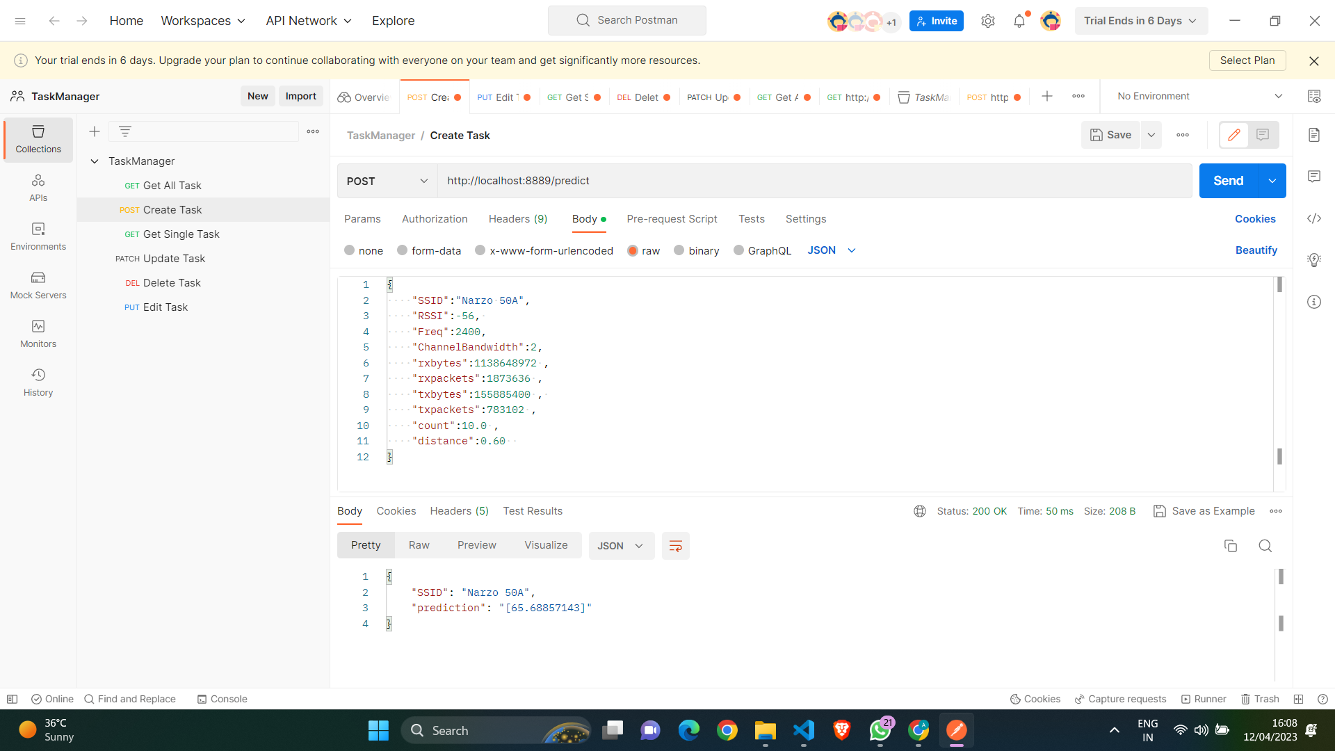
API Call
Actual vs Fit graph (Random Forest)

Slide 11
Further Plan to Complete Project
Final Probable Deliverables :
Android Application which a user can use to predict the best AP
Model will be running on FLask API
IP Target / Plan :
We have Started working on paper with title:
Predictive Wi-Fi Network Selection: Enhancing User Experience through an ML-based Approach

Slide 12
Further Plan to Complete Project
Completion Plan:
Week 1 to 2
Research paper phase 1 : Abstract, Introduction, Literature survey
Week 2 to 4
Research paper phase 2: Methodology, Algorithm, Result, Conclusion and future works.
Week 5 to 6
Paper presentation
Week 7 to 8
Challenges Anticipated:
Git Upload details: https://github.ecodesamsung.com/SRIB-PRISM/BMSCE_NCG06BMS_Best_AP_selection_using_AP_Score_prediction

Slide 13
Thank you

